Slide 1
Intangible Assets
ACC5AAI
Advanced Accounting Issues
Notes:
This is the Presentation Title page. Type over the existing content to add your title and subtitle.
This page uses the slide master for the Heading page.
It is recommended that you always include the date of your presentation in the subtitle.

Slide 2
REFERENCES
References:
Deegan, C, 2010, Australian Financial Accounting, Chapter 8
AASB 3 Business Combinations
AASB 138 Intangible Assets

Slide 3
Topic 4 CF: Assets cont
Last week we looked at the AASB accounting and reporting framework asset definition and recognition criteria
This week-the requirements relating to accounting for intangible assets

Slide 4
Specific learning objectives
Describe and apply the requirements relating to accounting for intangibles
Critically evaluate the treatment of goodwill and intangible assets such brand-names in the context of the conceptual framework

Slide 5
Intangibles-Definition
Non-monetary assets without physical substance
Includes patents, goodwill, mastheads, brand names, copyrights, research and development, and trademarks

Slide 6
Intangible assets-definitions
Identifiable intangible assets
  A specific value can be placed on each individual asset, and they can be separately identified and sold: eg. brand names, trademarks, research and development, patents, licenses, mastheads and copyrights
Unidentifiable intangible assets
  Intangible assets that cannot be separately sold: goodwill
Internally generated
  if developed within the organisation rather than being acquired at cost from an external party: eg?

Slide 7

World’s most recognised brand!
As at 2009:
  Book value of equity: $25billion
  Market value of equity: $203 billion
  Difference represents?

Slide 8
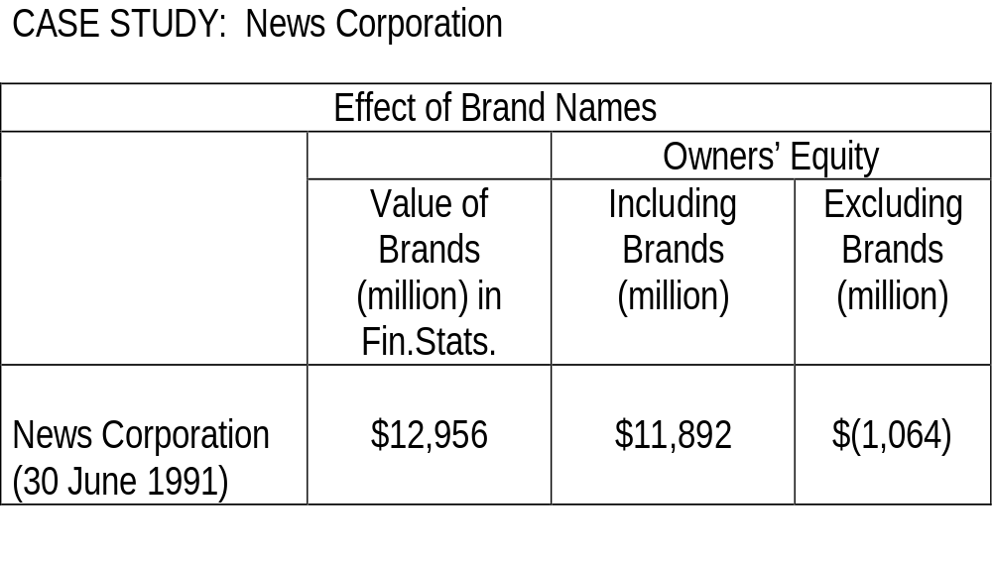
Are intangibles important?

Slide 9
Is this important Cont.?
They capitalised and did not depreciate as was permitted at the time.
Why do you think they did this?
Economic implications?

Slide 10
Goodwill
What is goodwill?
An unidentifiable intangible asset that cannot be individually identified and is an intrinsic part of the business
Cannot be purchased or sold separately, but only as part of an entity in its entirety
Represents the future economic benefits associated with an existing business model, customer base, efficient management, reliable suppliers, reputation etc.

Slide 11
Goodwill
What is goodwill? (cont.)
Could be built up over a number periods (internally generated) or obtained (purchased) by acquiring an existing business
AASB 3 Business Combinations defines goodwill as:
An asset representing the future economic benefits arising from other assets acquired in a business combination that are not individually identified and separately recognised

Slide 12
Goodwill and CF
Is it an “asset”?
  Control. How can something that cannot be identified be controlled?
  Past event
  Expected future economic benefit
Does it meet recognition criteria?
  Cost or other value can be measured reliably
  Future economic benefit is probable
Goodwill accounting has been controversial …

Slide 13
Goodwill: accounting requirements
Australian goodwill standard (NOW SUPERSEDED)
  Required amortisation of purchased goodwill
  Opposition from companies due to economic impact – argued standard resulted in financial statements that did not reflect economic reality
  Superseded by AASB 3 Business Combinations
A distinction is made between ‘internally generated’ and ‘purchased’ goodwill …

Slide 14
Internally generated goodwill:
Goodwill built up by a business - as opposed to goodwill which is purchased as part of a business acquisition
Recognition not permitted. Why?
Purchased goodwill is treated differently ...

Slide 15
Purchased goodwill: AASB 3 Business Combinations:
Initially recorded at ‘cost’: difference between purchase price and fair values of identifiable assets and liabilities
  Assumed purchase provides ‘reliable’ measure
  Assumed cost of ‘goodwill’
fair value-“the amount for which an asset could be exchanged or a liability settled, between knowledgeable, willing parties in an arms length transaction”
Amortisation of goodwill abolished
Annual impairment testing required, or more frequent testing if events or changes of circumstances indicate asset may be impaired
See lecture illustration 1

Slide 16
LECTURE ILLUSTRATION 1 :
PACDOWN LTD
On 1 January 20X5, Pacdown Ltd purchased all the assets and liabilities of Rota Ltd which manufactures the well known ‘Puke’ brand of running and leisure shoes. The purchase price was $4 000 000 cash plus due diligence and other costs of $200 000.

Slide 17
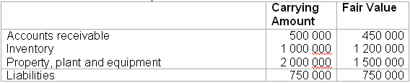
LI 1-PACDOWN cont.
The assets and liabilities as per the Balance Sheet of Rota Ltd were as follows:

Slide 18
As part of the due diligence, expert valuation of the ‘Puke’ brand name was commissioned. The expert valuation obtained was $1 000 000. The due diligence also uncovered a contingent liability arising from an ongoing court case. The experts undertaking the due diligence assessed the amount of the liability at $200 000. This measurement was considered reliable.
Required:
Record the acquisition of the assets and liabilities in the books of Pacdown Ltd as at 1 January, 20X5.

Slide 19
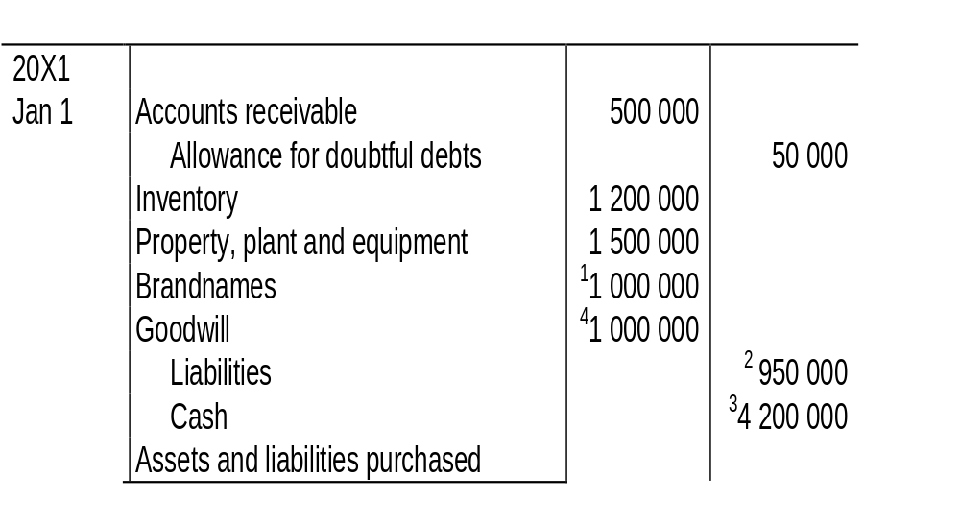
LI 1-Soln: Initial Recognition

Slide 20
Notes
1 Brand names have been recognised as an identifiable, intangible asset. This is required by AASB138 provided the assets fair value can be measured reliably.
2 Liabilities include the contingent liability arising from the legal action.

Slide 21
Notes-Cont.
3 Credit to bank includes purchase consideration $4 000 000 plus incidental costs of $200 000 in determining goodwill.
4 Goodwill = 1 000 000 (Purchase consideration $4.2m – fair value of identifiable net assets acquired $3.2m).

Slide 22
Goodwill: MCQs
1.Examples of elements of a business that commonly make up goodwill are:
A. Patents and licences.
B. Trademarks and brand names.
C. Research and development.
D. Established reputation and loyal customers.
E. All of the given answers.

Slide 23
Goodwill: MCQs cont.
The treatment of internally generated goodwill varies from purchased goodwill under AASB 138 in that:
A. Purchased goodwill is not amortised whereas internally generated goodwill is assumed to be maintained indefinitely.
B. Purchased goodwill may be recorded as an asset, whereas internally generated goodwill may not.
C. Internally generated goodwill is to be amortised over a period of no greater than 20 years, whereas purchased goodwill may not be recorded.
D. Purchased goodwill is to be expensed in the period it is bought whereas internally generated goodwill is to be deferred and amortised over a period of no less than 20 years.
E. None of the given answers.

Slide 24
Goodwill: “buzz group”
Why are purchased & internally generated goodwill accounted for differently?
Do you think companies with internally generated goodwill are disadvantaged by the accounting standard?
Do you think the different treatments affect the comparability of financial statements?
How/why is an impairment (decrease) in value reliable and relevant but not an increase?

Slide 25
Identifiable intangibles
Recognition by companies initially a consequence of perceived negative impact of goodwill standard
Proposed adoption of international standard (2000)
  Required write-off over 20 years or less; recognition of some intangibles not permitted
  Withdrawn due to lobbying!!
Adopted international standard (2005)
  AASB 138 Intangible assets (covers intangibles not covered by other standards) …

Slide 26
AASB 138 Intangible assets: Criteria for recognition:
Must be ‘identifiable’
Must meet asset definition (control, past event, expected future economic benefit) and recognition criteria (probable future economic benefit, and cost or other value can be reliably measured)
What is meant by identifiable? …

Slide 27
‘identifiable’ (para. 12)
Capable of being separated from the entity and sold, transferred, licensed, rented or exchanged
OR arise from contractual or other legal rights
Criteria more restrictive (severability) than/therefore inconsistent with CF!
AASB 138 distinguishes between ‘purchased’ and ‘internally generated’ identifiable intangibles …

Slide 28
AASB 138 Intangible assets : Separately ‘Purchased’ intangibles
‘identifiable’: purchase evidence of identifiability, represents ‘past event’ and assumed to indicate probability of future benefit
‘control’ (through ownership can “deny access …)
‘cost’ argued to be ‘reliable’ measure

Slide 29
AASB 138: Intangible assets: Purchased intangibles: Acquisition as part of a business
Recognised at ‘fair value’ if fair value can be measured reliably
‘fair value’ ‘can normally be measured with sufficient reliability’ (para. 35)
Market prices provide ‘most reliable measure’ (para. 39)
If no active market fair value can be estimated on basis of outcomes of recent transactions for similar assets OR using developed techniques eg. discounting estimated future cash flows

Slide 30
AASB 138 Intangible assets : Internally generated intangibles
‘identifiable’? Many costs recognised prior to AASB 138 will not be eg. re-organisations costs

Slide 31
‘Research’ and ‘development’
Definitions (AASB138):
Research: ‘original and planned investigation undertaken with the prospect of gaining new scientific or technical knowledge and understanding’
Development: ‘the application of research findings or other knowledge to a plan or design for the production of new or substantially improved materials, devices, products, processes, systems or services before the start of commercial production or use’

Slide 32
Accounting: Possible Approaches
1 Expense method :
  All R&D expenditure is expensed (US)
  Assumes?
  Too conservative?
2 Expense and reinstate method :
  Expense and reinstate if/when…..
  Some argue most consistent with CF

Slide 33
Accounting: Possible Approaches
3 Selective capitalisation :
  required in UK and AASB138
  research costs: expensed.
  development costs: capitalised, if they meet certain criteria
  Problem: assumes all research will be unsuccessful.

Slide 34
Accounting: Possible Approaches
4 Capitalisation method :
  All R&D costs capitalised and amortised
  Assumes all R&D expenditure satisfies asset defn. – overly aggressive?
5 Defer until success known :
  carry R&D costs in B/S as a deferred debit (ie not an asset)
  When outcome is more certain, expense or capitalise.
  Problem : contrary to CF - deferred debits ≠ assets.

Slide 35
‘Research’ and ‘development’ –AASB 138 Treatment
‘research’
  costs to be expensed. Why?
‘development’
  costs to be capitalised only when can demonstrate (para. 57)
    Technical feasibility of completion
    Intention to complete
    Availability of adequate resources to complete
    Ability to use or sell
    Ability to reliably measure cost
    How the intangible will generate probable future economic benefit

Slide 36
R&D Cont.
  recognition of internally generated brands, mastheads, publishing titles, customer lists and items similar in substance is prohibited (para. 63) as cost ‘cannot be distinguished from the cost of developing the business as a whole’ (para. 64)

Slide 37
AASB 138: subsequent treatment
‘Indefinite useful life’
  no foreseeable limit on the period over which asset is expected to generate cash flows.
  not to be amortised; indefinite useful life must be reassessed at each reporting period
‘Finite life’ - to be amortised and amortisation period and method reviewed at each reporting period
Revaluations of intangible assets to fair value are limited by reference to an ‘active market’ (intangibles not previously recognised cannot be revalued).

Slide 38
More MCQs
1. What is the test for deferral of research costs as required by AASB 138?
A. Research costs can be deferred (recorded as an asset) when it is probable that the project they are applied to will bring future economic benefits.
B. Research costs may not be deferred unless it is almost certain that the project they are applied to will bring future economic benefits.
C. Research costs may not be recorded as an intangible asset.
D. Research costs may be deferred if the entity can demonstrate that an intangible asset exists and that it will generate future economic benefits.
E. Research costs may be recorded as an intangible asset if the company intends to develop the product further.

Slide 39
More MCQs
2. The requirement of AASB 138 in relation to the amortisation of development cost is that:
A. It is to be amortised straight-line over a period not greater than 20 years.
B. It is to be amortised from the time of deferral so as to match the cost to the related benefits.
C. It is to be amortised using an accelerated depreciation rate over a period not exceeding 10 years.
D. It is to be amortised from the time the asset is available for use and shall reflect the consumption of the economic benefits by the entity.
E. None of the given answers.

